Slide 1
`IoT • EMBEDDED SYSTEMS • HEALTHCARE ASSISTANCE
SMART BEDSIDE PATIENT MONITORING & NURSE CALL SYSTEM
A Fault-Tolerant, Accountable Communication & Vital-Sign Monitoring Network for Hospital Care
PROJECT TEAM & ATTRIBUTION
• Team Leader: Kavitha M
• Team Members: Jayasri P | Iniyan A K | Manokrithik TP
• Faculty Mentor: Mr. Mahendar Embedded Trainer
CDC/Assistant professor ECE

Slide 2
SMART BEDSIDE PATIENT MONITORING & NURSE CALL SYSTEM
Problem Statement & Proposed Solution
THE HEALTHCARE COMMUNICATION GAP
• Speech & Mobility Barriers
Patients with limited physical movement or speech impairment struggle to call for immediate assistance.
• Unaddressed Calls & Missing Logs
Traditional call lights lack automated response tracking, leaving calls unanswered with no accountability.
• Connectivity Vulnerabilities
Standard remote monitoring systems fail completely when Wi-Fi or hospital network outages occur.
OUR ESP32-BASED PROTOTYPE SOLUTION
✔ Dual Bedside Input System
Combines an emergency push button with a multi-category touchscreen interface (Water, Pain, Nurse, Toilet).
✔ Central Dashboard & Timeout Escalation
Displays active calls in real time and automatically routes unanswered calls to secondary caregivers after timeout.
✔ Offline Fail-Safe Resilience
Triggers local bedside buzzer/LED alarms instantly and stores logs in EEPROM memory during network loss.

Slide 3
SMART BEDSIDE PATIENT MONITORING & NURSE CALL SYSTEM
Core Objectives & Key Innovation
01. ACCESSIBLE REQUESTS
Provide non-verbal touchscreen & push-button help inputs for bedridden patients.
02. CONTEXT-RICH ALERTS
Transmit bed ID, request category, and RTC timestamp directly to nurse stations.
03. RESPONSE TRACKING
Record exact caregiver acknowledgement and call resolution timestamps.
04. TIMED ESCALATION
Automatically route unacknowledged calls to secondary staff after a set timeout.
05. OFFLINE RESILIENCE
Maintain local buzzer alarms and EEPROM event buffers during Wi-Fi outages.
06. AUDITABLE RECORDS
Generate downloadable CSV/PDF response logs for shift audits and quality review.
KEY DIFFERENTIATOR: Response Acknowledgement + Automatic Timeout Escalation + Local Offline Alarms + Audit Logging.

Slide 4
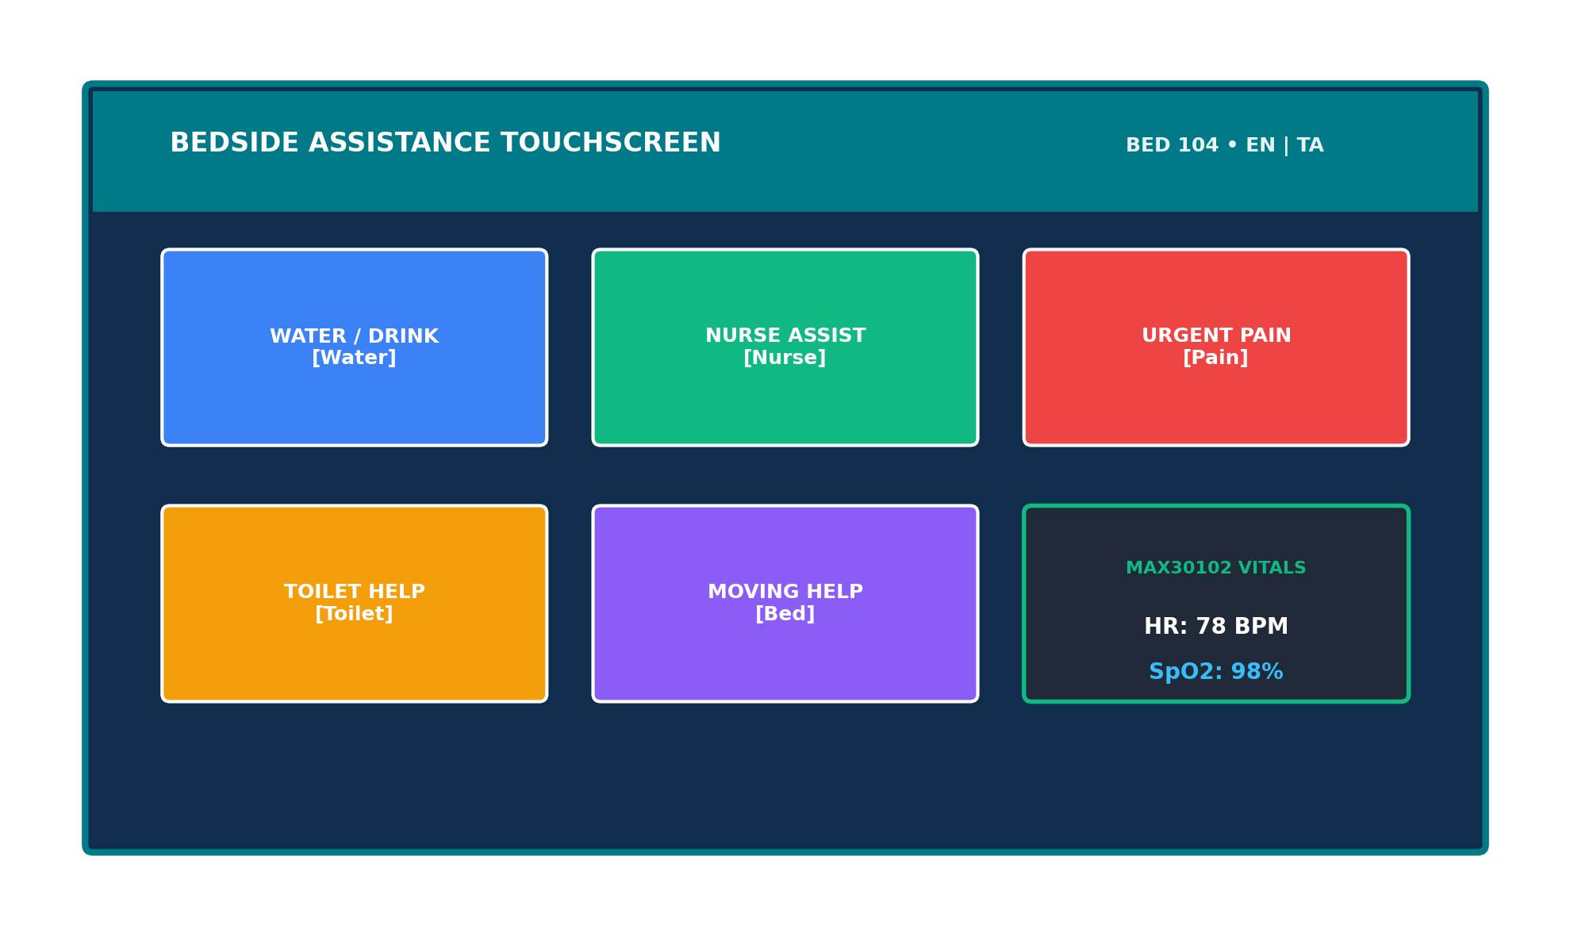
SMART BEDSIDE PATIENT MONITORING & NURSE CALL SYSTEM
System Features & Bedside Touchscreen UI
CORE SYSTEM CAPABILITIES
• Vital-Sign Dashboard
Displays estimated heart rate (BPM) and SpO2 from the MAX30102 sensor with pulse quality indicators.
• Touchscreen Assistance
Quick-select icons for Water, Pain, Nurse Assist, Toilet, and Mobility Assistance.
• Smart Alerts & Escalation
Combines instant bedside audio-visual indicators with automated dashboard alerts.
• Digital Patient Reports
Generates comprehensive shift reports and CSV/PDF response analytics.
• Bilingual Accessibility
Supports high-contrast UI layouts with English and Tamil language toggles.
BEDSIDE TOUCHSCREEN UI & MAX30102 VITALS
Integrates quick-select category icons (Water, Nurse, Pain, Toilet, Bed) with live heart rate (BPM) and SpO2 vital sign estimates in a dual-language (English/Tamil) interface.

Slide 5
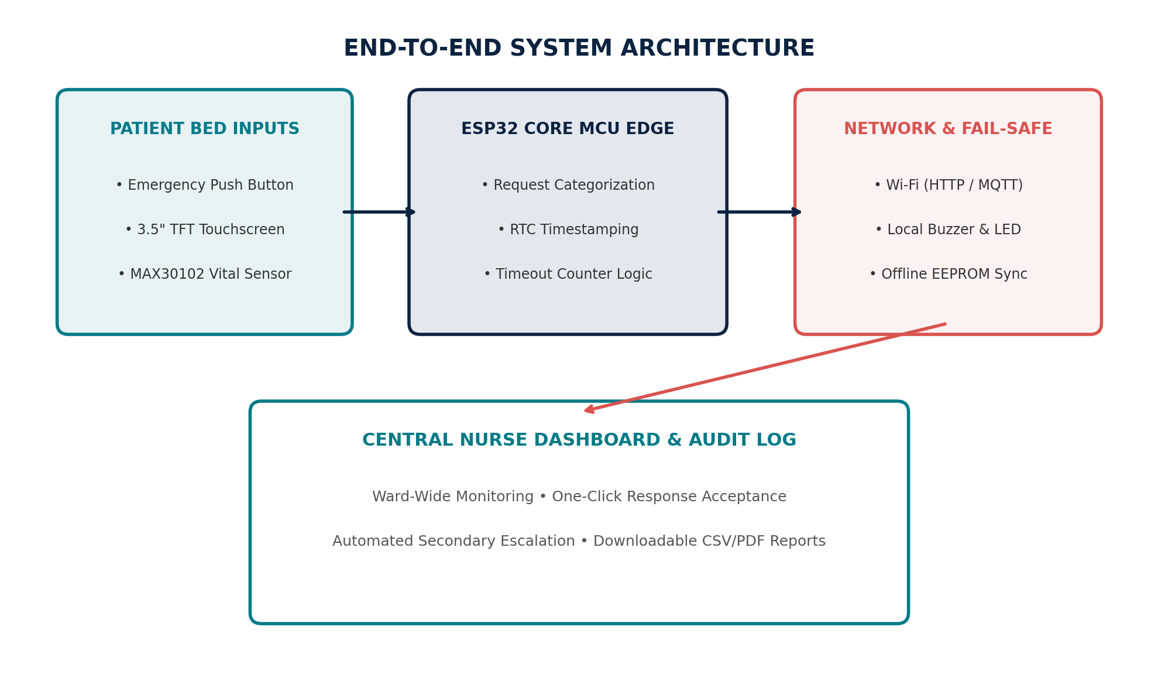
SMART BEDSIDE PATIENT MONITORING & NURSE CALL SYSTEM
System Architecture & Communication Flow
ARCHITECTURAL LAYERS
• 1. Patient Edge Node
ESP32 microcontroller interfaces with touchscreen, push button, and MAX30102 vital sign sensor.
• 2. Local Alarm Layer
Triggers instant local buzzer and LED indicators at bedside for immediate immediate awareness.
• 3. Network Transport Layer
Transmits encrypted event packets via HTTP/MQTT over hospital Wi-Fi.
• 4. Dashboard & Database
Central Web UI displays active ward calls, logs timestamps, and manages escalation timers.
MULTI-TIER SYSTEM ARCHITECTURE
End-to-end data flow connecting bedside touch/button inputs, local ESP32 processing, Wi-Fi network transport, central nurse station dashboard, and EEPROM fail-safe backup.

Slide 6
SMART BEDSIDE PATIENT MONITORING & NURSE CALL SYSTEM
Healthcare Uses & Alert Lifecycle
6-STAGE CALL LIFECYCLE
Healthcare Applications of CareConnect
Emergency Nurse Call: Enables patients to request immediate assistance from nurses.
Centralized Monitoring: Displays patient requests from multiple beds on a single dashboard.
Health Monitoring: Measures heart rate and estimated SpO₂ using the MAX30102 sensor.
Alert System: Uses a buzzer and LED for local alerts and notifications.
Digital Record Management: Tracks patient requests and maintains records for better follow-up.
1. REQUEST
Patient presses push button or selects touchscreen category.
2. REGISTER
ESP32 logs event with patient bed ID & RTC timestamp.
3. ALERT
Bedside buzzer sounds & dashboard displays active call.
4. ACKNOWLEDGE
Primary nurse accepts call; local/remote alarm stops.
5. ESCALATE
Unacknowledged call auto-routes to secondary staff after timeout.
6. CLOSE & REPORT
Caregiver closes request; logs export to CSV/PDF.

Slide 7
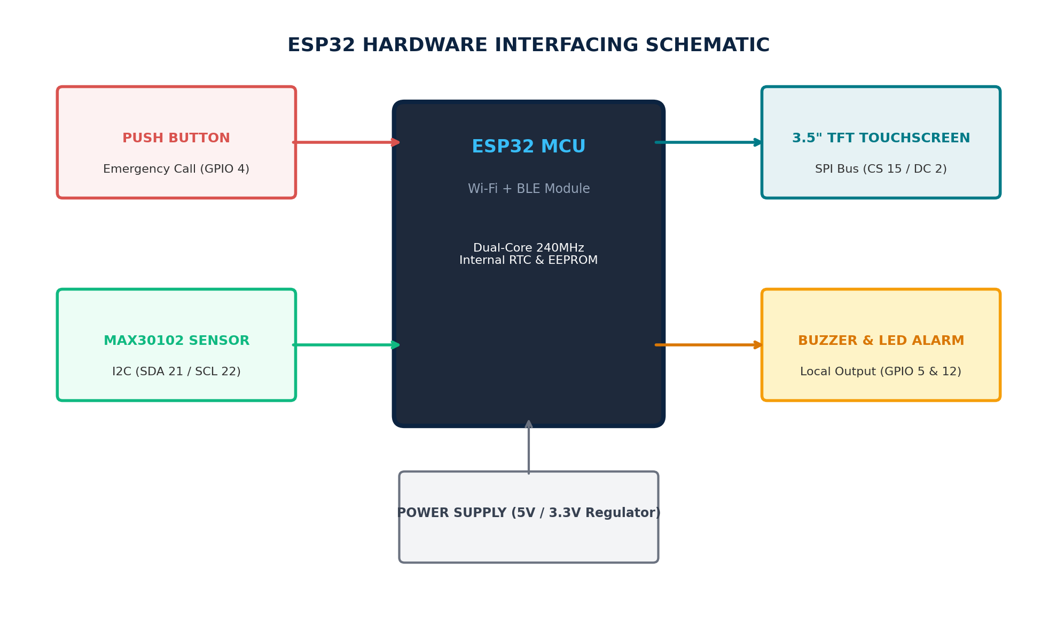
SMART BEDSIDE PATIENT MONITORING & NURSE CALL SYSTEM
Hardware & Software Stack
HARDWARE & SOFTWARE SPECIFICATIONS
• ESP32 MCU Board
Dual-core 240MHz microcontroller with built-in Wi-Fi, BLE, and internal EEPROM.
• 3.5" TFT Touchscreen
SPI-driven high-contrast touch UI for multi-category help selections.
• MAX30102 Vital Sensor
I2C optical heart rate and SpO2 estimation module with noise filtering.
• Emergency Button & Alarm
Direct GPIO push button, piezo buzzer, and status LED for instant local alerts.
HARDWARE PIN INTERFACING SCHEMATIC
Pin assignment map for ESP32 core controller interfacing with GPIO 4 (Button), I2C SDA/SCL 21/22 (MAX30102), SPI bus (TFT display), and GPIO 5/12 (Buzzer/LED).

Slide 8
SMART BEDSIDE PATIENT MONITORING & NURSE CALL SYSTEM
Feasibility, Social Impact & Safety Boundary
TECHNICAL FEASIBILITY
• Low-Cost Hardware
Constructed using widely available, off-the-shelf COTS embedded components.
• Modular Architecture
Allows easy scaling from single-bed prototypes to ward-wide hospital deployments.
SOCIAL IMPACT
• Patient Empowerment
Provides an intuitive voice-free call system for bedridden and speech-impaired patients.
• Reduced Nurse Fatigue
Categorized requests prioritize urgent calls and streamline nursing workflows.
SCALABILITY
• Hospital Integration
Supports MQTT/HTTP data integration into existing hospital management software.
• Audit Compliance
Automated timestamps ensure transparent response records for hospital accreditation.
IMPORTANT SAFETY BOUNDARY & TECHNICAL DISCLAIMER
• Assistance Aid, Not Life-Critical Monitor: This system is designed strictly as an accountable bedside communication and vital monitoring aid. It is NOT certified for life-critical ICU alarm monitoring.
• Vital-Sign Estimation Scope: MAX30102 heart rate and SpO2 estimates provide general trend awareness and early warning context; they do not replace clinical-grade medical diagnostic instruments.
• Fail-Safe Redundancy: In the event of total power loss or micro-controller fault, traditional mechanical bedside call systems should remain as secondary physical backup.

Slide 9
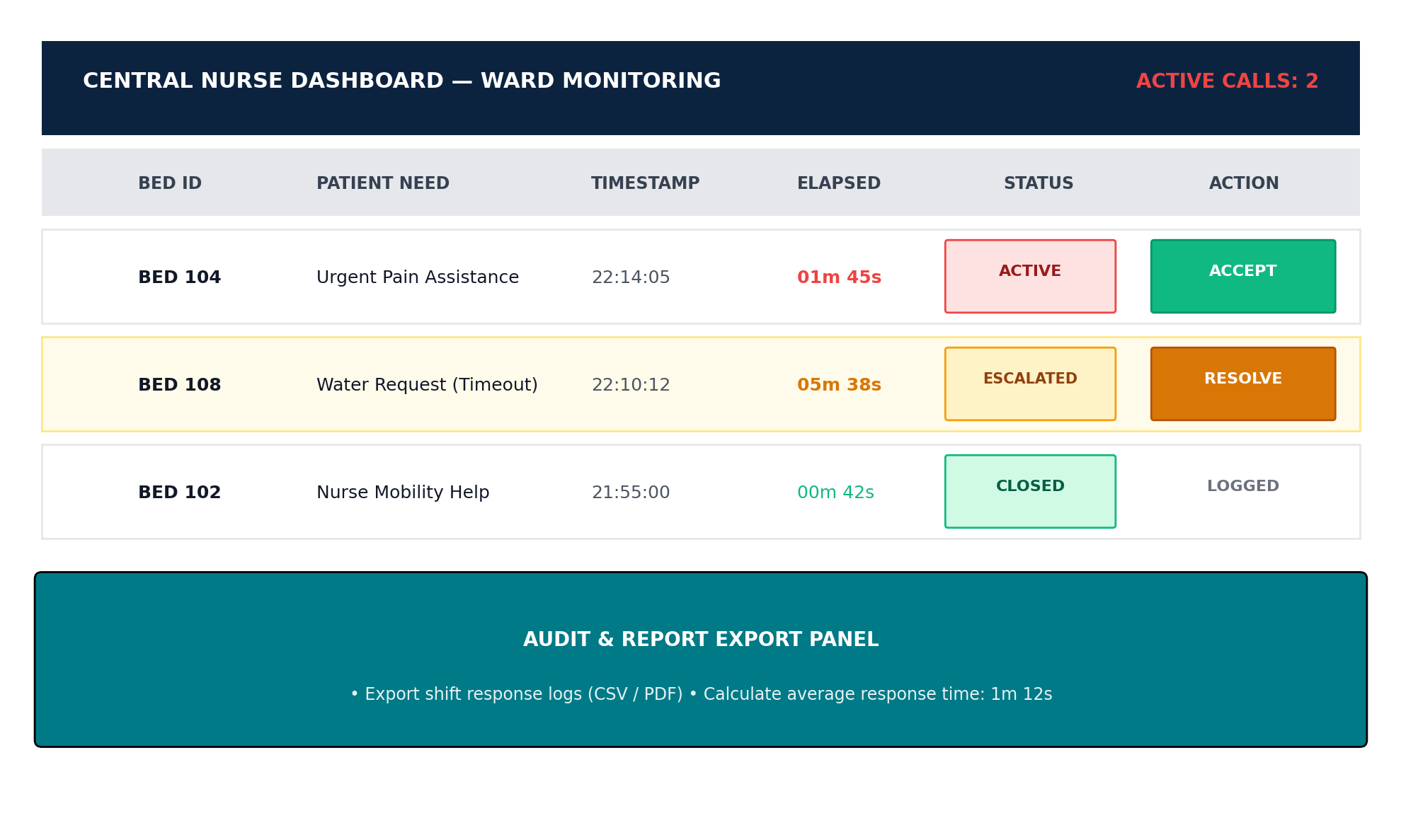
SMART BEDSIDE PATIENT MONITORING & NURSE CALL SYSTEM
Expected Prototype Demonstration Output
PROTOTYPE VALIDATION RESULTS
✔ Patient Touchscreen Display
Successfully renders multi-category request icons, bed status, and MAX30102 pulse/SpO2 readings.
✔ Nurse Station Dashboard
Real-time web portal displaying ward bed status, active calls, and response time counters.
✔ Automated Escalation Trigger
Demonstrated secondary alert routing when primary calls remain unacknowledged past timeout.
✔ Offline Fail-Safe Test
Verified local buzzer activation and EEPROM event logging during simulated Wi-Fi disconnects.
CENTRAL NURSE DASHBOARD UI
Real-time ward monitoring console displaying active calls, elapsed response time counters, color-coded status badges (Active, Escalated, Closed), and shift report exporters.

Slide 10
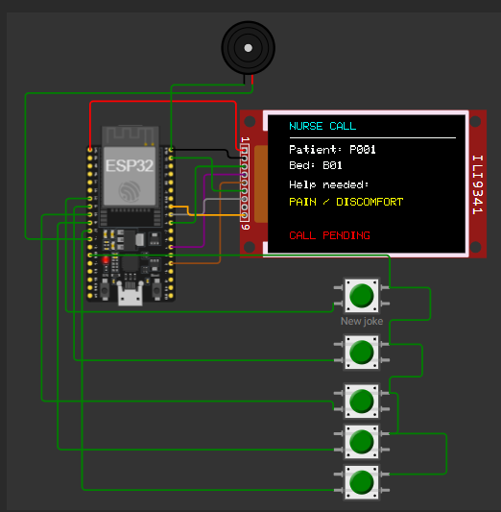
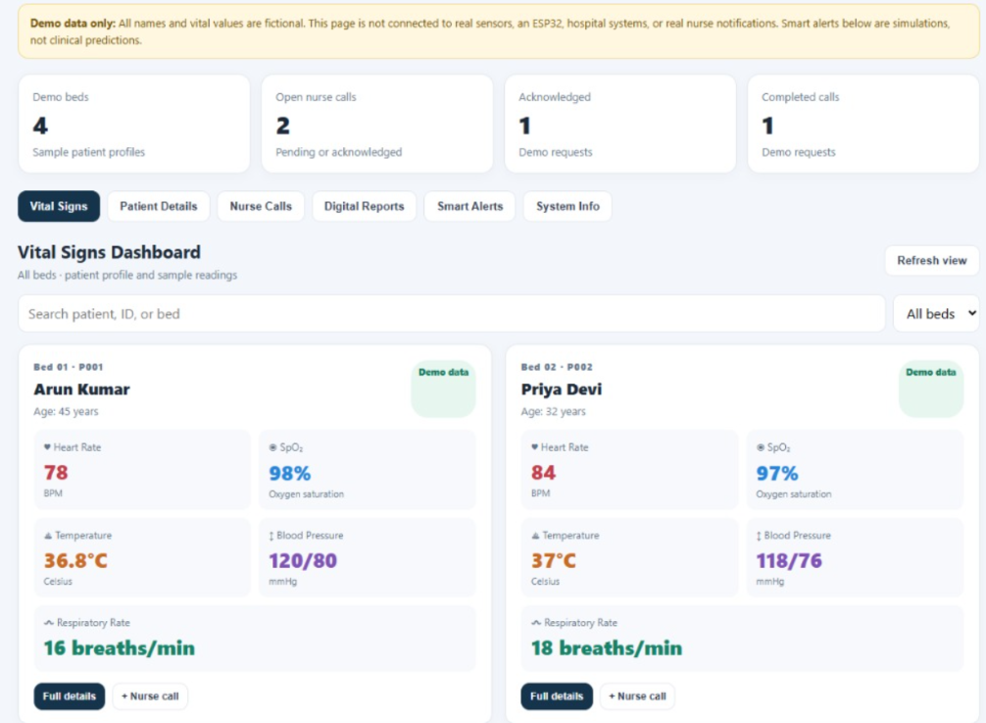
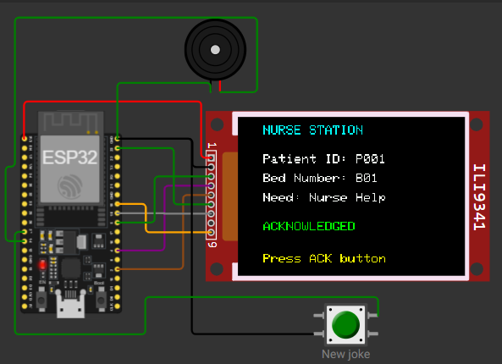
Hardware Output
Software Output
Patient
Nurse

Slide 11
THANK YOU
Accessible Care • Accountable Response • Better Patient Communication

